Slide 1
Simple excel model
PVT
Data
PVT
Data
PVT Calc
PVT Calc
Storage Calc
Storage Calc
Storage Data
Storage Data
House Calc
House Calc
t = 0
t = 1
etc.
House
Data
House
Data

Slide 2
Better? OOP model
PVT Calc
PVT Calc
Mediator
Mediator
PVT
Data
PVT
Data
Storage Calc
Storage Calc
Mediator
Mediator
Storage
Data
Storage
Data
t = 0
t = 1
etc.
House Calc
t = 1
House Calc
Mediator
Mediator
House
Data
House
Data

Slide 3
Proposed OOP model
Defined by GUI
Economic Data
System Layout
Geodata
Mediator
House Calc
Component Calc
Data
House
Data
PVT Calc
Energy Balance
Storage Calc
PVT
Data
Cost Calc
Storage Data

Slide 4
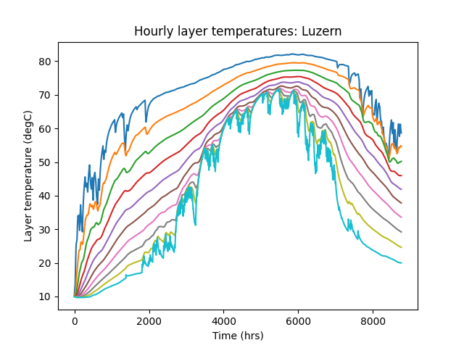
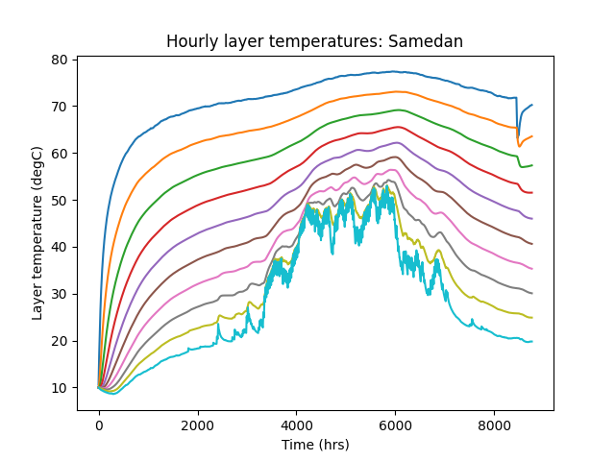
Seems to work…

Slide 5
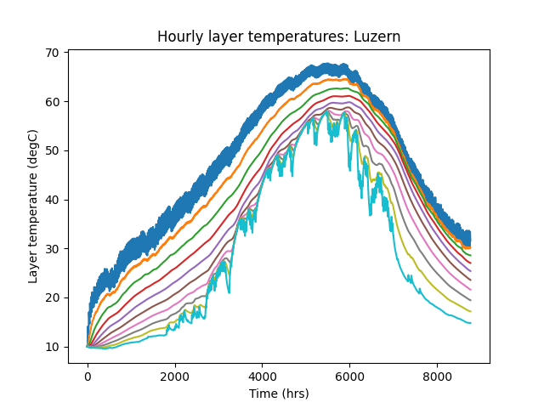
Beware effects of averaging…

